Slide 1
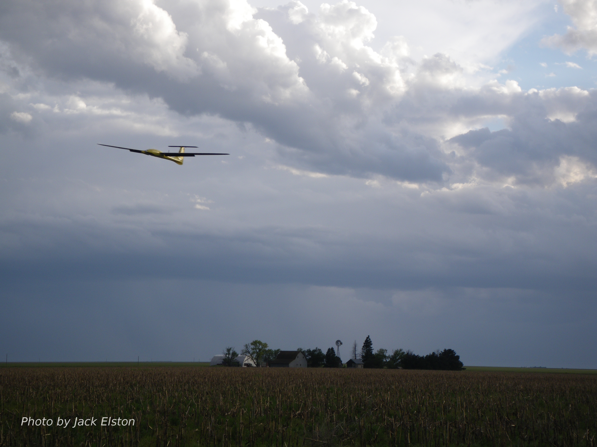
Chapter 10
Path Following

Slide 2
Control Architecture
destination, obstacles
map
path planner
waypoints
status
path manager
path definition
tracking error
path following
airspeed, altitude,
heading,
commands
position error
autopilot
servo commands
state estimator
unmanned aircraft
wind
on-board sensors

Slide 3
Path Following
For small UAVs, a major issue is wind
Always present to some degree
Usually significant with respect to commanded airspeed
Wind makes traditional trajectory tracking approaches difficult, if not infeasible
Have to know the wind precisely at every instant to determine desired airspeed
Better approach: path following
Rather than “follow this trajectory”, we control UAV to “stay on this path”

Slide 4
Path Types
We will focus on two types of paths to follow:
Straight lines between two points in 3-D
Inclination of path within climb capabilities of UAV
Circular orbits or arcs in the horizontal plane
Paths for common applications can be built up from these path primitives
Methods for following other types of paths found in literature

Slide 5
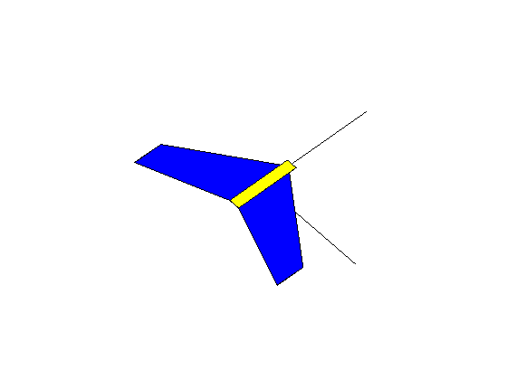
Straight Line Path Description
north
east
Notes:
\noindent
$\mathbf{r}$: vector defining initiation of path \\
$\mathbf{q}$: unit vector defining direction of path \\
$\mathbf{p}$: vector defining location of MAV \\
$\chi_q$: course direction of path \\
$e_{\mathit{py}}$: lateral tracking error

Slide 6
Lateral Tracking Problem
north
east
Notes:
\noindent Path error:
\[
\mathbf{e}_p = \begin{pmatrix}e_{px} \\ e_{py} \\
e_{pz} \end{pmatrix}
\defeq \mathcal{R}_i^{\mathcal{P}}\left(\mathbf{p}^i-\mathbf{r}^i\right)
\]
where the transformation from inertial frame to path frame is
\[
\mathcal{R}_i^{\mathcal{P}} \defeq \begin{pmatrix}
\cos\chi_q &
\sin\chi_q & 0 \\
-\sin\chi_q &
\cos\chi_q & 0 \\
0 & 0 & 1 \end{pmatrix}
\]

Slide 7
Lateral Tracking Problem
north
east
Notes:
\noindent Relative error dynamics in path frame:
\begin{align*}
\begin{pmatrix} \dot{e}_{px} \\ \dot{e}_{py} \end{pmatrix}
&= \begin{pmatrix} \cos\chi_q & \sin\chi_q \\ -\sin\chi_q & \cos\chi_q \end{pmatrix}
\begin{pmatrix} V_g\cos\chi \\ V_g\sin\chi \end{pmatrix} \notag\\
&= V_g \begin{pmatrix} \cos(\chi-\chi_q) \\
\sin(\chi-\chi_q)
\end{pmatrix}
\end{align*}
Regulate the cross-track error $e_{py}$ to zero by commanding the course angle:
\begin{align*}
\dot{e}_{py} &= V_g\sin(\chi-\chi_q)\\
\ddot{\chi} &= b_{\dot{\chi}}(\dot{\chi}^c-\dot{\chi}) + b_{\chi}(\chi^c-\chi)
\end{align*}
Select $\chi^c$ so that $e_{py}\to 0$

Slide 8
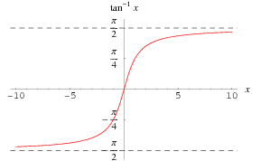
Lateral Tracking - Vector Field Concept
Notes:
\noindent Desired course based on
cross-track error:
\[
\chi_d(e_{py}) =
-\chi^\infty\frac{2}{\pi}\tan^{-1}(k_{\text{path}}e_{py})
\]
--
\noindent For a general line, the commanded course is
\[
\chi^c = \chi_q - \chi^\infty\frac{2}{\pi}\tan^{-1}(k_{\text{path}}e_{py})
\]

Slide 9
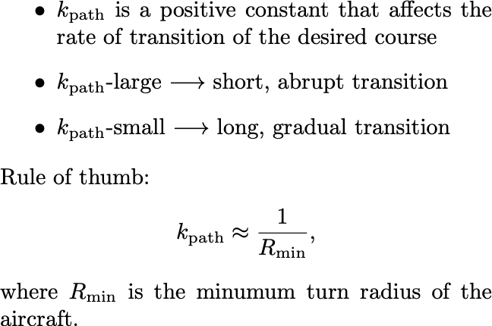
Vector Field Tuning
Notes:
\begin{itemize}
\item $k_{\text{path}}$ is a positive constant that affects
the rate of transition of the desired course
\item $k_{\text{path}}$-large $\longrightarrow$ short, abrupt transition
\item $k_{\text{path}}$-small $\longrightarrow$ long, gradual transition
\end{itemize}
\noindent Rule of thumb:
\[
k_{\text{path}}\approx \frac{1}{R_{\min}},
\]
where $R_{\min}$ is the minumum turn radius of the aircraft.

Slide 10
Lyapunov’s 2nd Method
Notes:
\noindent
For a system having a state vector $x$, consider an energy-like (Lyapunov) function $V(x): \mathbb{R}^n \mapsto \mathbb{R}$ such that
\begin{align*}
V(x) &> 0, \forall x\neq 0 \text{ (positive definite)} \\
V(0) &= 0 \\
\text{and}& \\
\dot{V}(x) &< 0, \forall x\neq 0 \text{ (negative definite)} \\
\dot{V}(0) &= 0.
\end{align*}
\noindent
If such a function $V(x)$ can be defined, then $x$ goes to zero asymptotically and the system is stable.

Slide 11
Lateral Tracking Stability Analysis
Notes:
\noindent Define the Lyapunov function $W(e_{py}) = \frac{1}{2}e_{py}^2$
\vspace{0.5cm}
\noindent Assume that course controller works and $\chi=\chi_q + \chi^d(e_{py})$
\vspace{0.5cm}
\noindent Since
\begin{align*}
\dot{W} &= e_{\mathit{py}}\dot{e}_{\mathit{py}} \\
&= -V_a e_{py}
\sin\left(\chi^\infty\frac{2}{\pi}\tan^{-1}(k_{\text{path}}e_{py})\right) \\
&< 0
\end{align*}
for $e_{py}\ne0$, then $e_{py}\to 0$ asymptotically

Slide 12
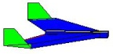
Longitudinal Tracking Problem
Notes:
\mathbf{e}_p^i = \begin{pmatrix} e_{pn} \\ e_{pe} \\ e_{pd} \end{pmatrix} \defeq \mathbf{p}^i - \mathbf{r}^i = \begin{pmatrix} p_n-r_n \\ p_e-r_e \\ p_d-r_d \end{pmatrix}
\mathbf{n} = \frac{\mathbf{q}\cross \mathbf{k}^i}{\norm{\mathbf{q}\cross \mathbf{k}^i}}
\mathbf{s}^i &= \begin{pmatrix} s_n \\ s_e \\ s_d \end{pmatrix} \\
&= \mathbf{e}_p^i - (\mathbf{e}_p^i \cdot \mathbf{n}) \mathbf{n}
12

Slide 13
Longitudinal Tracking Problem
Notes:
By similar triangles
\[
\frac{(h_d+r_d)}{\sqrt{s_{n}^2+s_{e}^2}} = \frac{-q_d}{\sqrt{q_n^2+q_e^2}}
\]
Desired altitude based on current location
\[
h_d(\mathbf{r},\mathbf{p},\mathbf{q}) = -r_d - \sqrt{s_{n}^2+s_{e}^2} \left(\frac{q_d}{\sqrt{q_n^2+q_e^2}} \right)
\]
\framebox{
Select $h^c$ so that $h\to h_d(\mathbf{r},\mathbf{p},\mathbf{q})$
}
13

Slide 14
Longitudinal Guidance Strategy
Notes:
\noindent Use altitude state machine from Ch. 6.
\noindent Closed-loop altitude dynamics:
\[
h(s) = \left(\frac{b_{\dot{h}}s + b_h}{s^2 + b_{\dot{h}}s + b_h}\right) h^c(s).
\]
%
Altitude error:
\[
e_h \doteq h_d(\mathbf{r},\mathbf{p},\mathbf{q}) - h = h^c-h
\]
Error dynamics:
\begin{align*}
e_h(s) &= \left(1 - h(s) \right) h^c(s) \\
&= \left(\frac{s^2 + b_{\dot{h}}s + b_h}{s^2 + b_{\dot{h}}s + b_h} - \frac{b_{\dot{h}}s + b_h}{s^2 + b_{\dot{h}}s + b_h}\right) h^c(s) \\
&= \left(\frac{s^2}{s^2 + b_{\dot{h}}s + b_h}\right) h^c(s)
\end{align*}
%
Applying FVT:
\begin{align*}
e_{h,ss} &= \lim_{s \to 0} s \; \frac{s^2}{s^2 + b_{\dot{h}}s + b_h} \; h^c \\
&= 0, \;\;\;\;\;\; \text{for $h^c = \frac{H_0}{s}, \frac{H_0}{s^2}$ }
\end{align*}

Slide 15
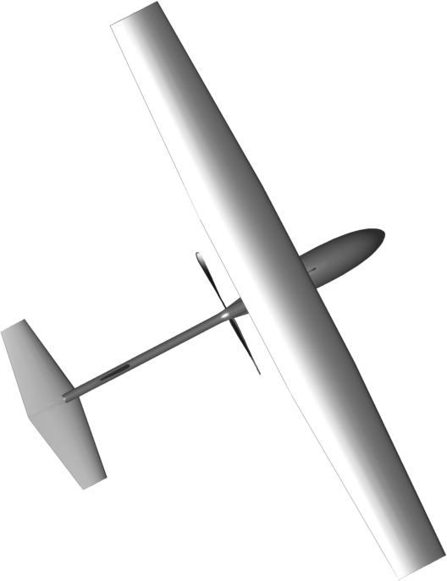
Smallest Angle Turn Logic

Slide 16
Orbit Following
Notes:
Orbit definition:
\[
\mathcal{P}_{\text{orbit}}(\mathbf{c},\rho,\lambda) =
\left\{\mathbf{r}\in\re^3 : \mathbf{r} = \mathbf{c} +
\lambda\rho\begin{pmatrix}\cos\varphi, & \sin\varphi & 0
\end{pmatrix}^{\top}, \varphi \in [0,2\pi) \right\}
\]
--
\noindent
Center: $\mathbf{c}\in\mathbb{R}^3$ \\
Radius: $\rho\in\mathbb{R}$ \\
Direction: $\lambda = 1$ (CW) or $\lambda=-1$ (CCW)
\vspace{0.5cm}
\noindent
In polar coordinates, the position of MAV given by: \\
$d \doteq \sqrt{(p_n-c_n)^2 + (p_e-c_e)^2}$: \\
$\varphi \doteq \tan^{-1}\left( \frac{p_e-c_e}{p_n-c_n} \right)$: \\
16

Slide 17
Orbit Following
Notes:
\noindent Easiest to analyze in polar coordinates. Using
\[
\begin{pmatrix} \dot{p}_n \\ \dot{p}_e \end{pmatrix}
= \begin{pmatrix}
V_g\cos\chi \\
V_g\sin\chi
\end{pmatrix}
\]
and converting to polar coordinates gives
\begin{align*}
\begin{pmatrix} \dot{d} \\ d\dot{\varphi} \end{pmatrix}
&= \begin{pmatrix}
\cos\varphi & \sin\varphi \\
-\sin\varphi & \cos\varphi
\end{pmatrix}
\begin{pmatrix} \dot{p}_n \\ \dot{p}_e \end{pmatrix} \\
&= \begin{pmatrix}
\cos\varphi & \sin\varphi \\
-\sin\varphi & \cos\varphi
\end{pmatrix}
\begin{pmatrix}
V_g\cos\chi \\
V_g\sin\chi
\end{pmatrix} \\
&= \begin{pmatrix} V_g\cos(\chi-\varphi) \\ V_g\sin(\chi-\varphi) \end{pmatrix}
\end{align*}
The result is
\begin{empheq}[box=\fbox]{align*}
\dot{d} &= V_g\cos(\chi-\varphi) \\
\dot{\varphi} &= \frac{V_g}{d}\sin(\chi-\varphi) \label{eq:vec-varphidot} \\
\ddot{\chi} &= -b_{\dot{\chi}}\dot{\chi} + b_{\chi}(\chi^c-\chi) \\
\end{empheq}
17

Slide 18
Orbit Following
Notes:
\noindent Define
\[
\chi^o = \varphi + \lambda\frac{\pi}{2}
\]
When $d \gg \rho \quad \rightarrow \quad \chi_d \approx \chi^o + \lambda\frac{\pi}{2}$.
\\
When $d = \rho \quad \rightarrow \quad \chi_d = \chi^o$
\\
Therefore, let the desired course angle be
\[
\chi_d(d-\rho,\lambda) = \chi^o + \lambda
\tan^{-1}\left(k_{\text{orbit}}\left(\frac{d-\rho}{\rho}\right)\right)
\]
18

Slide 19
Orbit Tracking Stability Analysis

Slide 20
Orbit Following
Notes:
\noindent {\bf The commanded course is:~~~~~}
\(
\chi^c(t) = \varphi + \lambda \left[ \frac{\pi}{2}+
\tan^{-1}\left(k_{\text{orbit}}\left(\frac{d-\rho}{\rho}\right)\right)
\right]
\)
\vspace{0.5cm}
\noindent {\bf The orbit angle must be wrapped:~~~~}
\(
\varphi = \text{atan2}(p_e-c_e, p_n-c_n) + 2\pi m
\)
20

Slide 21
Roll Feedforward: no wind
Notes:
\noindent For orbit following:
\[
\chi^c(t) = \varphi + \lambda\left[\frac{\pi}{2} + \tan^{-1}\left(k_{\text{orbit}}\left(\frac{d-\rho}{\rho}\right)\right)\right].
\]
\noindent Note:
\begin{align*}
d-\rho=0 \qquad &\implies \qquad \chi^c = 0 \\
&\implies \qquad \phi^c = 0 \\
&\implies \qquad \text{UAV will immediately deviate from orbit.}
\end{align*}
\noindent Problem can be fixed by commanding a roll feedforward for when aircraft is on the orbit.
\vspace{0.5cm}
\noindent If on the orbit and no wind, then
\[
\dot{\psi}^d = \lambda \frac{V_a}{\rho}.
\]
Coordinated turn condition:
\[
\dot{\psi}=\frac{g}{V_a}\tan\phi.
\]
Equating and solving for roll gives
\begin{equation}\label{eq:ff_no_wind}
\phi_{ff} = \lambda \tan^{-1}\left(\frac{V_a^2}{g\rho}\right).
\end{equation}
21

Slide 22
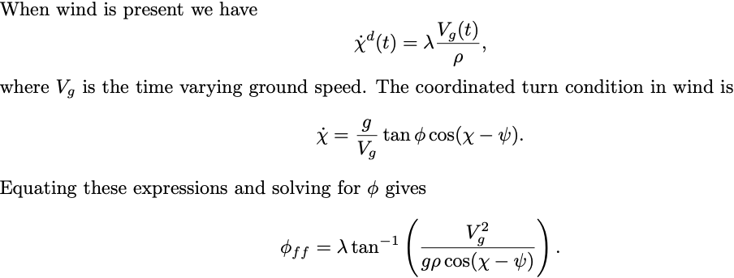
Roll Feedforward: wind
Notes:
\begin{minipage}{6.0in}\par\noindent
\noindent When wind is present we have
\[
\dot{\chi}^d(t) = \lambda \frac{V_g(t)}{\rho},
\]
where $V_g$ is the time varying ground speed.
The coordinated turn condition in wind is
\[
\dot{\chi} = \frac{g}{V_g}\tan\phi\cos(\chi-\psi).
\]
Equating these expressions and solving for $\phi$ gives
\[
\phi_{ff} = \lambda \tan^{-1}\left(\frac{V_g^2}{g\rho\cos(\chi-\psi)}\right).
\]
%Or equivalently
%\[
%\phi_{ff} = \lambda \tan^{-1}\left(\frac{\left(\left(w_n\cos\chi+w_e\sin\chi\right) + \sqrt{V_a^2 - (w_n\sin\chi-w_e\cos\chi)^2-w_d^2}\right)^2}
% {g\rho\sqrt{\frac{V_a^2 - (w_n\sin\chi-w_e\cos\chi)^2 - w_d^2}{V_a^2-w_d^2}}}\right),
%\]
\end{minipage}
22

Slide 23
Dubins Airplane Model
Adapted from: Mark Owen, Randal W. Beard, Timothy W. McLain, “Implementing Dubins Airplane Paths on Fixed-wing UAVs,” Handbook of Unmanned Aerial Vehicles, ed. Kimon P. Valavanis, George J. Vachtsevanos, Springer Verlag, Section XII, Chapter 68, p. 1677-1702, 2014.
horizontal component
of airspeed vector
Flight path projected onto ground
Notes:
\noindent {\bf Dubins Airplane model:}
\begin{align*}
\dot{r}_n &= V\cos\psi \cos\gamma^c \\
\dot{r}_e &= V\sin\psi \cos\gamma^c \\
\dot{r}_d &= -V\sin\gamma^c \\
\dot{\psi} &= \frac{g}{V}\tan\phi^c
\end{align*}
\noindent Where the commanded flight path angle $\gamma^c$ and the commanded roll angle $\phi^c$ are constrained by
\begin{align*}
|\phi^c| &\leq \bar{\phi} \\
|\gamma^c| &\leq \bar{\gamma}.
\end{align*}

Slide 24
3D Vector Field Path Following
Adapted from: V. M. Goncalves, L. C. A. Pimenta, C. A. Maia, B. C. O. Durtra, G. A. S. Pereira, B. C. O. Dutra, and G. A. S. Pereira, “Vector Fields for Robot Navigation Along Time-Varying Curves in n-Dimensions,” IEEE Transactions on Robotics, vol. 26, pp. 647–659, Aug 2010.
Notes:
\noindent The path is specified as the intersection of two 2D manifolds given by
\begin{align*}
\alpha_1(\mathbf{r})&=0 \\
\alpha_2(\mathbf{r})&=0
\end{align*}
$\mathbf{r}\in\mathbb{R}^3$.
Define the composite function
\[
W(\mathbf{r}) = \frac{1}{2}\alpha_1^2(\mathbf{r}) + \frac{1}{2}\alpha_2^2(\mathbf{r}),
\]
Note that the gradient
\[
\frac{\partial W}{\partial \mathbf{r}} = \alpha_1(\mathbf{r})\frac{\partial \alpha_1}{\partial \mathbf{r}}(\mathbf{r}) + \alpha_2(\mathbf{r})\frac{\partial \alpha_2}{\partial \mathbf{r}}(\mathbf{r}).
\]
points away from the path.

Slide 25
3D Vector Field Path Following
Notes:
\noindent The desired velocity vector can be chosen as
\[
\mathbf{u}' = \underbrace{- K_1 \frac{\partial W}{\partial \mathbf{r}}}_{\text{velocity directed toward the path}} + \underbrace{K_2 \frac{\partial \alpha_1}{\partial \mathbf{r}} \times \frac{\partial \alpha_2}{\partial \mathbf{r}}}_{\text{velocity directed along the path}}
\]
where $K_1>0$ and $K_2$ are symmetric tuning matrices, and the definiteness of $K_2$ determines the direction of travel along the path.
\vspace{1cm}
\noindent Since $\mathbf{u}'$ may not equal $V_a$, normalize to get
\[
\mathbf{u} = V_a\frac{\mathbf{u}'}{\|\mathbf{u}'\|}.
\]

Slide 26
3D Vector Field Path Following
Notes:
\noindent Setting the NED components of the velocity of the Dubins airplane model to $\mathbf{u} = (u_1, u_2, u_3)^\top$ gives
\begin{align*}
V\cos\psi^d \cos\gamma^c &= u_1\\
V\sin\psi^d \cos\gamma^c &= u_2 \\
-V\sin\gamma^c &= u_3.
\end{align*}
Solving for $\gamma^c$, and $\psi^d$ results in
\begin{align*}
\gamma^c &= -\text{sat}_{\bar{\gamma}}\left[\sin^{-1}\left(\frac{u_3}{V}\right) \right] \\
\psi^d &= \text{atan2}(u_2,u_1).
\end{align*}
Assuming the inner-loop lateral-directional dynamics are accurately modeled by the coordinated-turn equation, the commanded roll angle is
\[
\phi^c = \text{sat}_{\bar{\phi}}\left[k_{\phi}(\psi^d - \psi)\right],
\]
where $k_\phi$ is a positive constant.

Slide 27
3D Vector Field – Straight Line path
Notes:
The straight line path is given by
\[
\mathcal{P}_{\text{line}}(\mathbf{c}_\ell,\psi_\ell,\gamma_\ell) = \left\{
\mathbf{r}\in\mathbb{R}^3 : \mathbf{r} = \mathbf{c}_\ell +
\sigma\mathbf{q}_\ell, \sigma\in\mathbb{R} \right\},
\]
where
\[
\mathbf{q}_\ell = \begin{pmatrix} q_n \\ q_e \\ q_d \end{pmatrix} = \begin{pmatrix} \cos\psi_\ell\cos\gamma_\ell \\ \sin\psi_\ell\cos\gamma_\ell \\ -\sin\gamma_\ell \end{pmatrix}.
\]
Define
\begin{align*}
\mathbf{n}_{\text{lon}} &= \begin{pmatrix}-\sin\psi_\ell \\ \cos\psi_\ell \\ 0 \end{pmatrix} \\
\mathbf{n}_{\text{lat}} &= \mathbf{n}_{\text{lon}} \times \mathbf{q}_\ell = \begin{pmatrix}-\cos\psi_\ell\sin\gamma_\ell \\ -\sin\psi_\ell\sin\gamma_\ell \\ -\cos\gamma_\ell \end{pmatrix},
\end{align*}
to get
\begin{align*}
\alpha_{\text{lon}}(\mathbf{r}) &= \mathbf{n}_{\text{lon}}^\top (\mathbf{r}-\mathbf{c}_\ell) = 0 \\
\alpha_{\text{lat}}(\mathbf{r}) &= \mathbf{n}_{\text{lat}}^\top (\mathbf{r}-\mathbf{c}_\ell) = 0.
\end{align*}

Slide 28
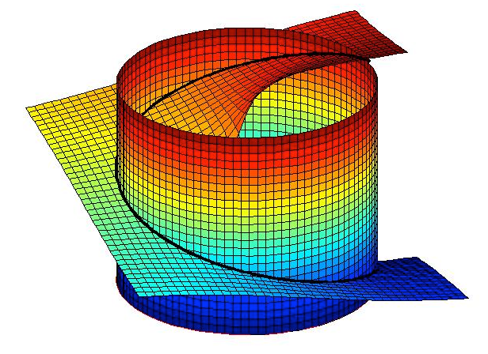
3D Vector Field – Helical Path
Notes:
\noindent A helical path is then defined as
\[
\mathcal{P}_{\text{helix}}(\mathbf{c}_h, \psi_h, \lambda_h, \rho_h, \gamma_h) = \{ \mathbf{r}\in\mathbb{R}^3: \alpha_{\text{cyl}}(\mathbf{r})=0 \text{~and~} \alpha_{\text{pl}}(\mathbf{r})=0 \}.
\]
where
\begin{align*}
\alpha_{\text{cyl}}(\mathbf{r}) &= \left(\frac{r_n-c_n}{\rho_h}\right)^2+\left(\frac{r_e-c_e}{\rho_h}\right)^2 - 1 \\
\alpha_{\text{pl}}(\mathbf{r}) &= \left(\frac{r_d-c_d}{\rho_h}\right) + \frac{\tan\gamma_h}{\lambda_h}\left(\tan^{-1}\left(\frac{r_e-c_e}{r_n-c_n}\right)-\psi_h\right)
\end{align*}
where the initial position along the helix is
\[
\mathbf{r}(0) = \mathbf{c}_h + \begin{pmatrix} \rho_h\cos\psi_h \\ \rho_h\sin\psi_h \\ 0 \end{pmatrix},
\]
and where $\mathbf{c}_h$ is the center of the helix, $\rho_h$ is the radius, $\gamma_h$ is the climb angle.

